Slide 1
Zigbee demonstration
Farbod Yadollahi
Saba Nasiri

Slide 2
Zigbee architectures: platform designs for Nordic
Zigbee architectures
Network co-processor
SoC
Multi protocol
Single protocol

Slide 3
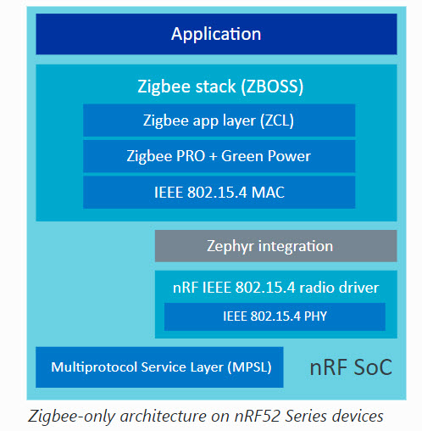
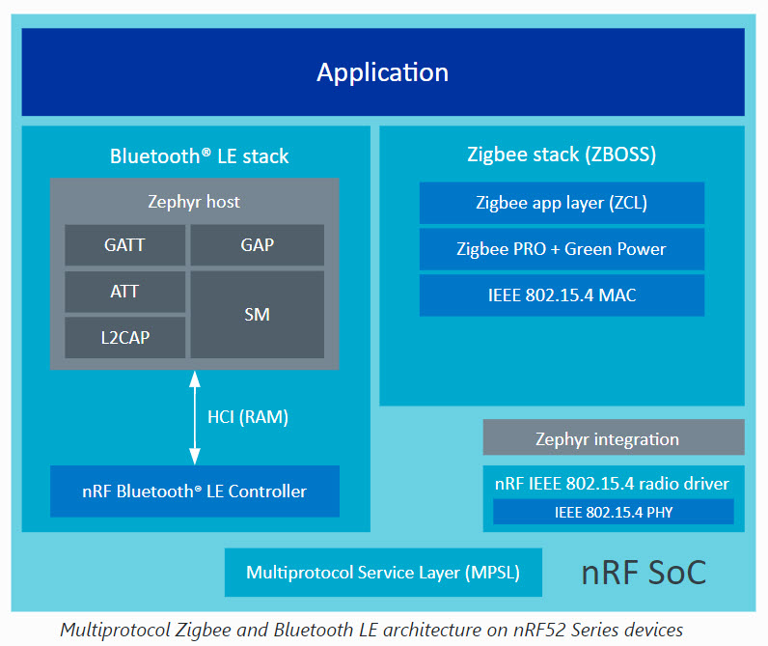
SoC Architectures

Slide 4
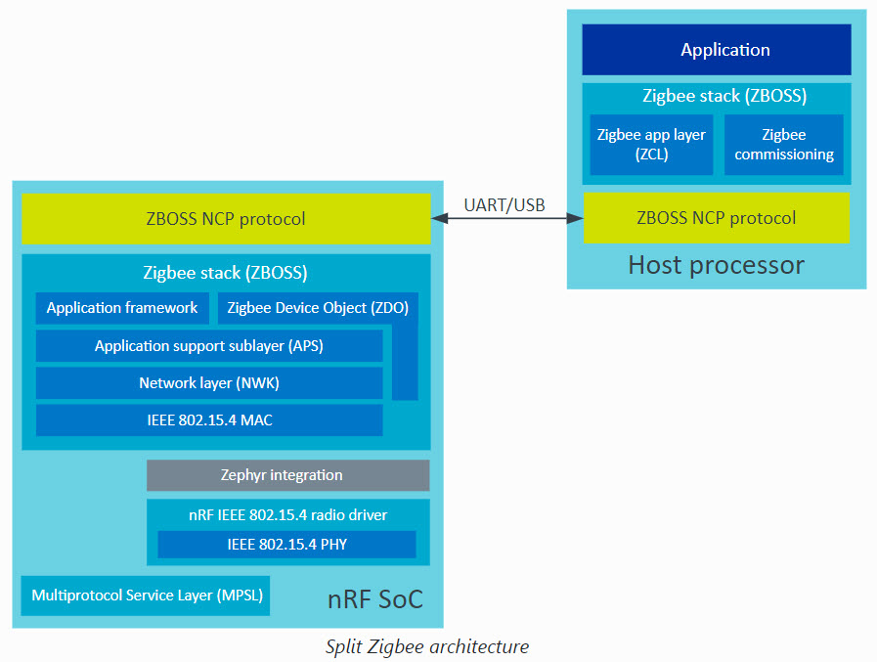
Network Co-Processor Architecture

Slide 5
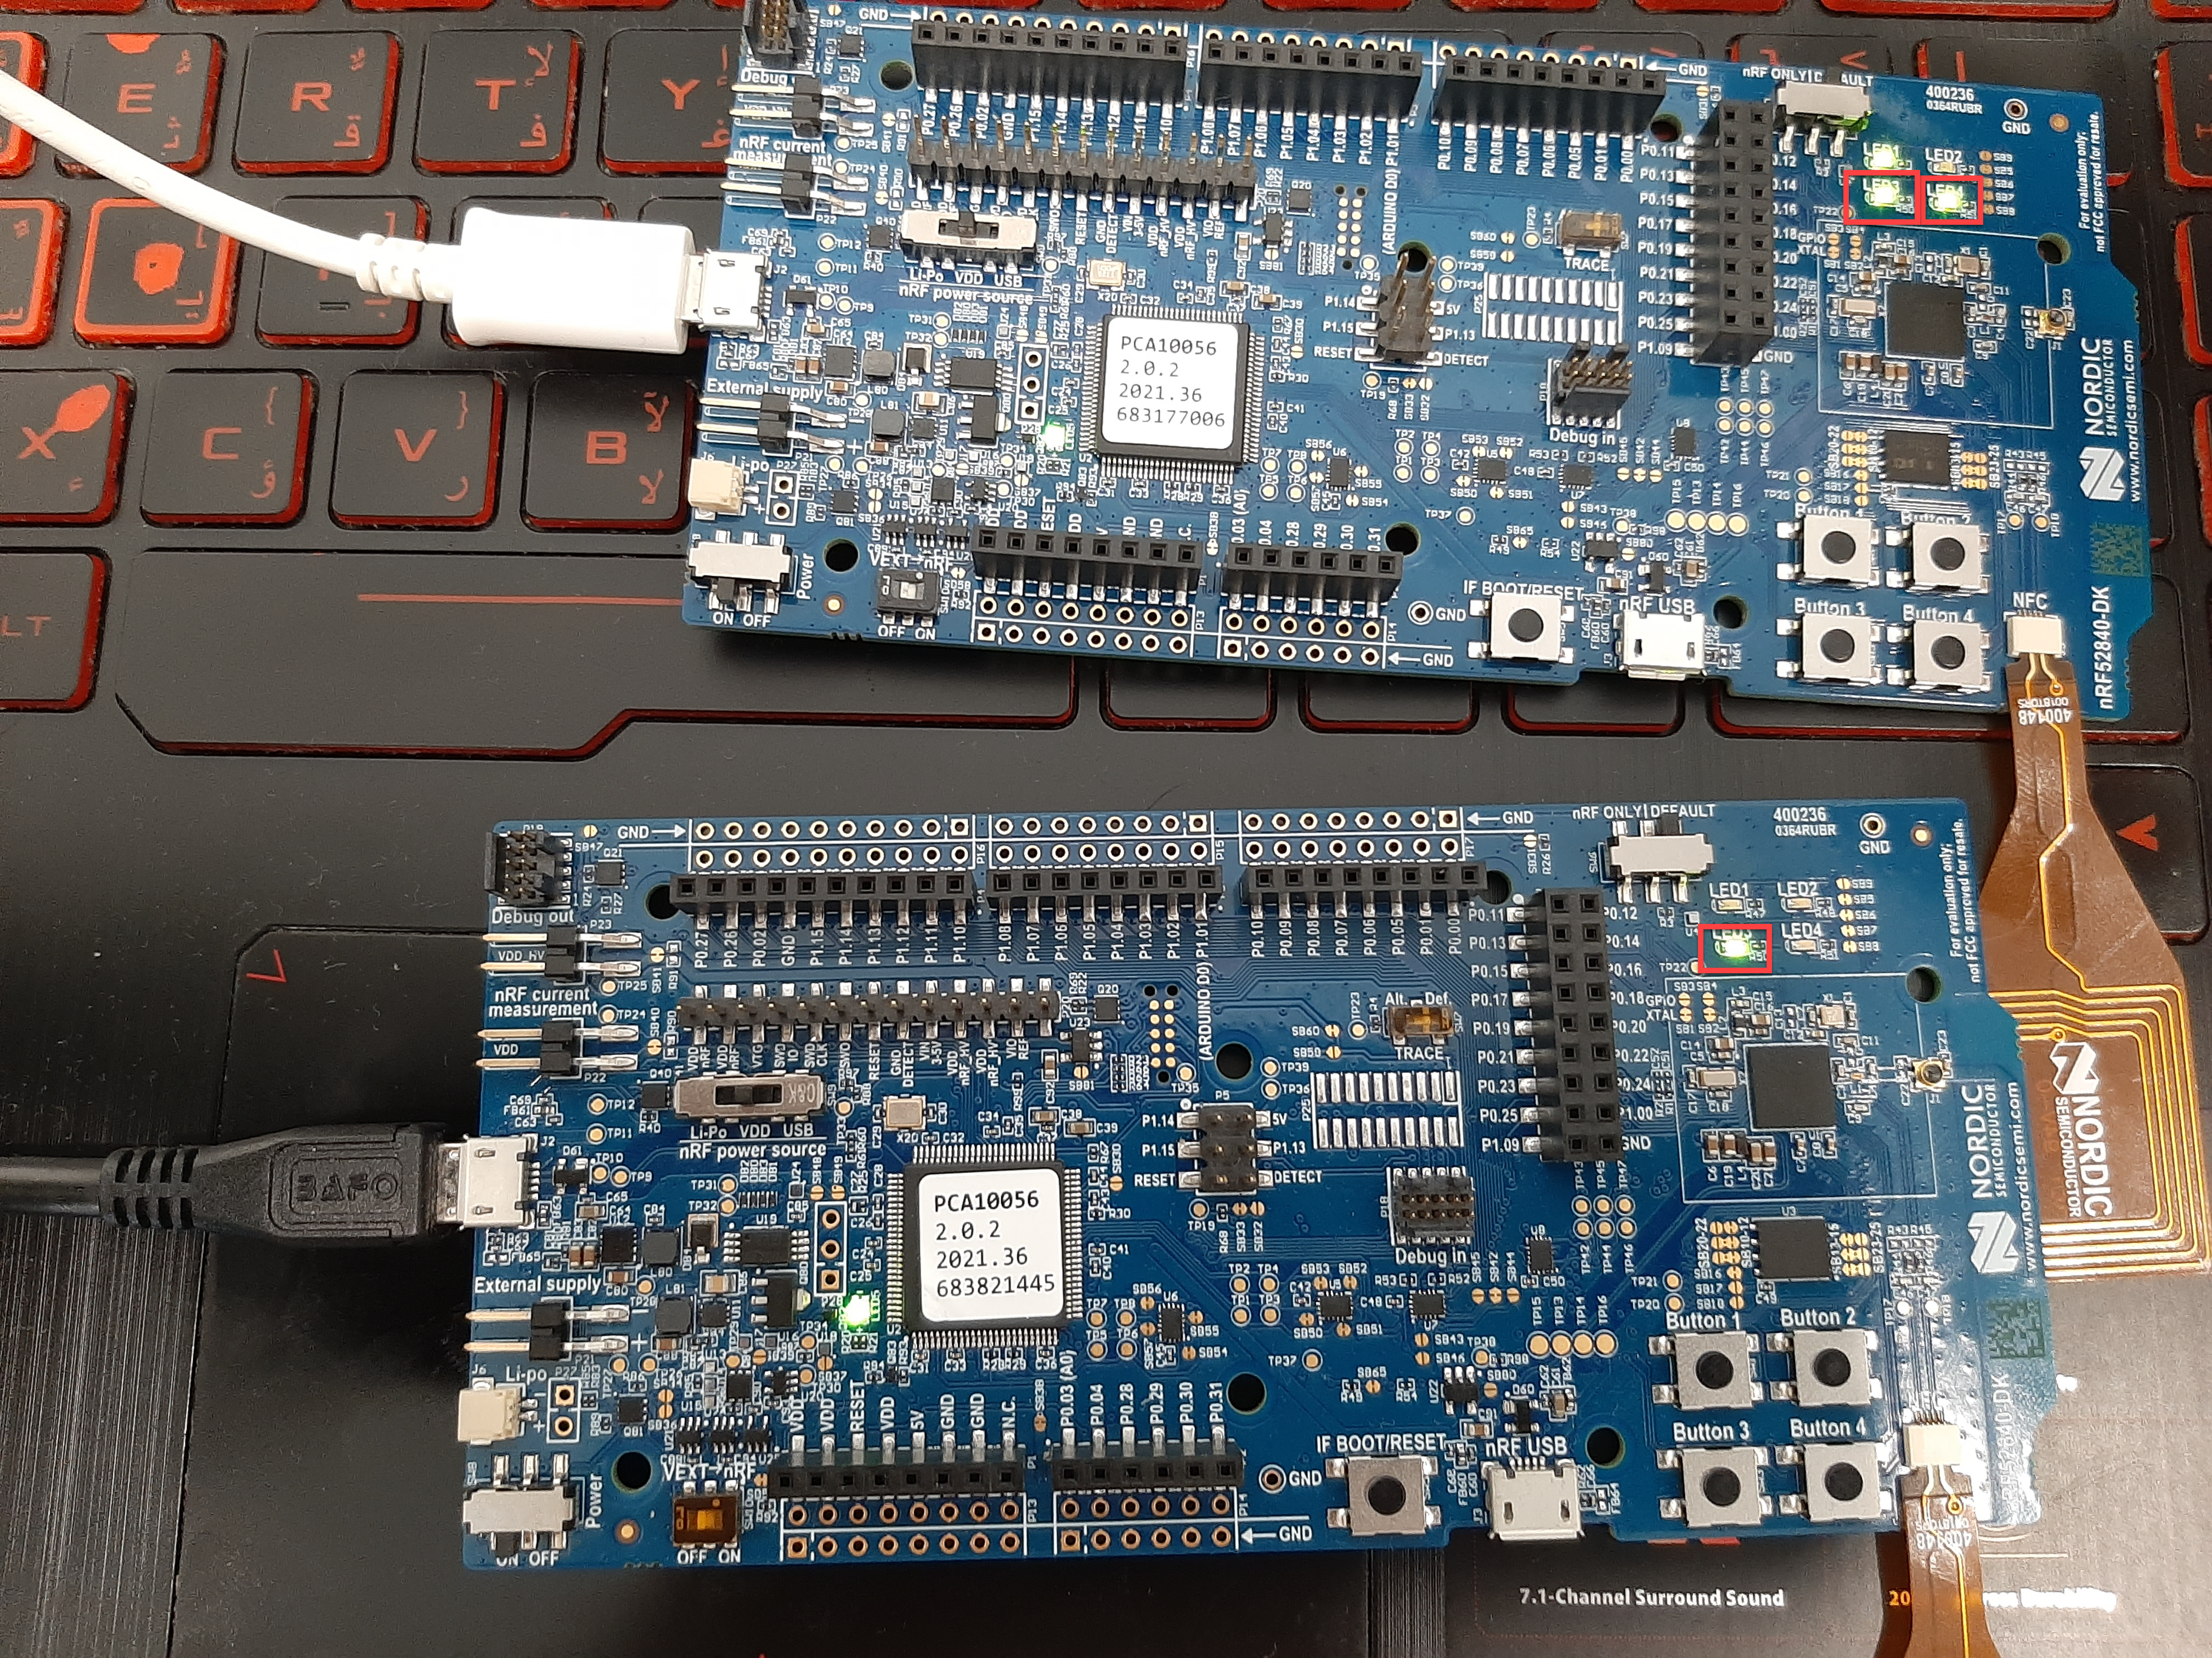
SoC single protocol demonstration
Indicates the dimmable light option, that is changes to the light bulb brightness. It can be controlled by another Zigbee device in the network, for example a light switch. Blinks when the light bulb is in Identify mode.
Turns on when the light bulb joins the network.
Indicates whether the network is open or closed:
On - The network is open.
Off - The network is closed.

Slide 6
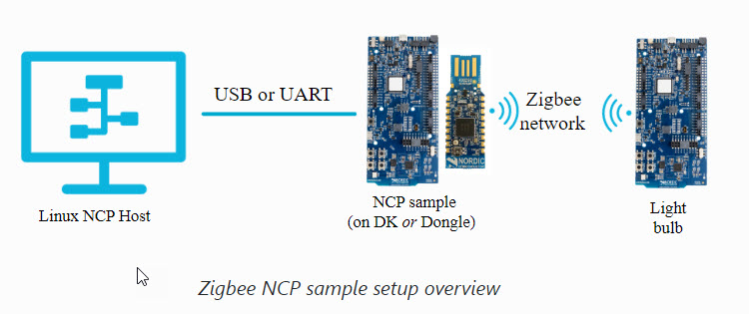
Network Co-Processor (NCP) demonstration: configuration

Slide 7
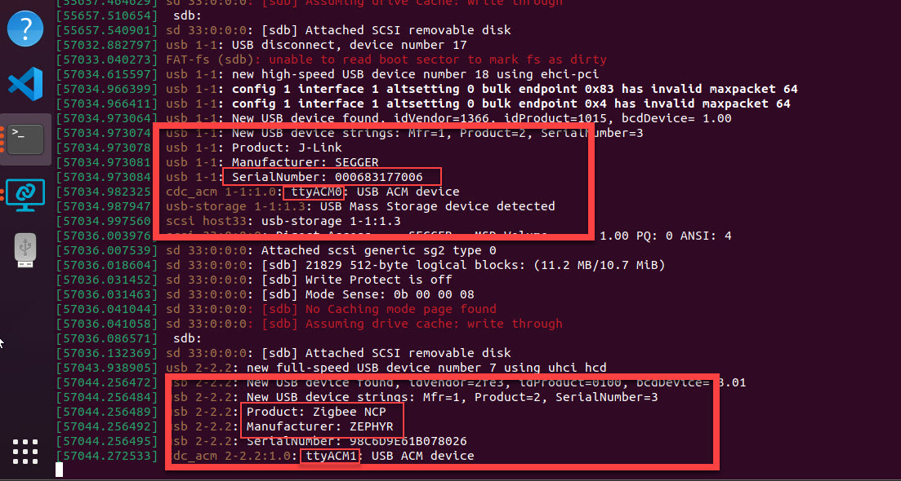
Board programming commands
nRF52840 dk:
$ nrfjprog --program ncp_fw/<firmware> --chiperase
$ nrfjprog --program ncp_fw/<firmware> --reset
nRF52840 dongle:
$ nrfutil dfu usb-serial -pkg ncp_fw/ncp.usb.nrf52840dongle_nrf52840.zip -p /dev/ttyACMx

Slide 8
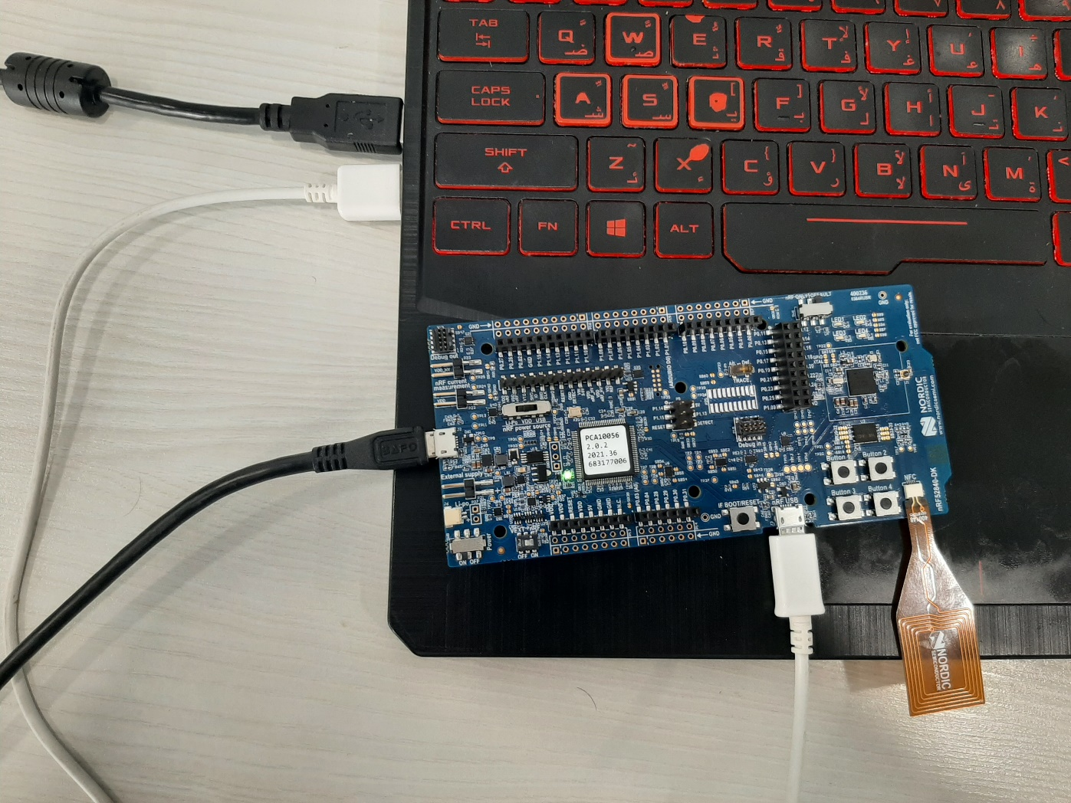
nRF52840 dk Physical connection
Power supply
nRF USB: for host and Soc Connection

Slide 9
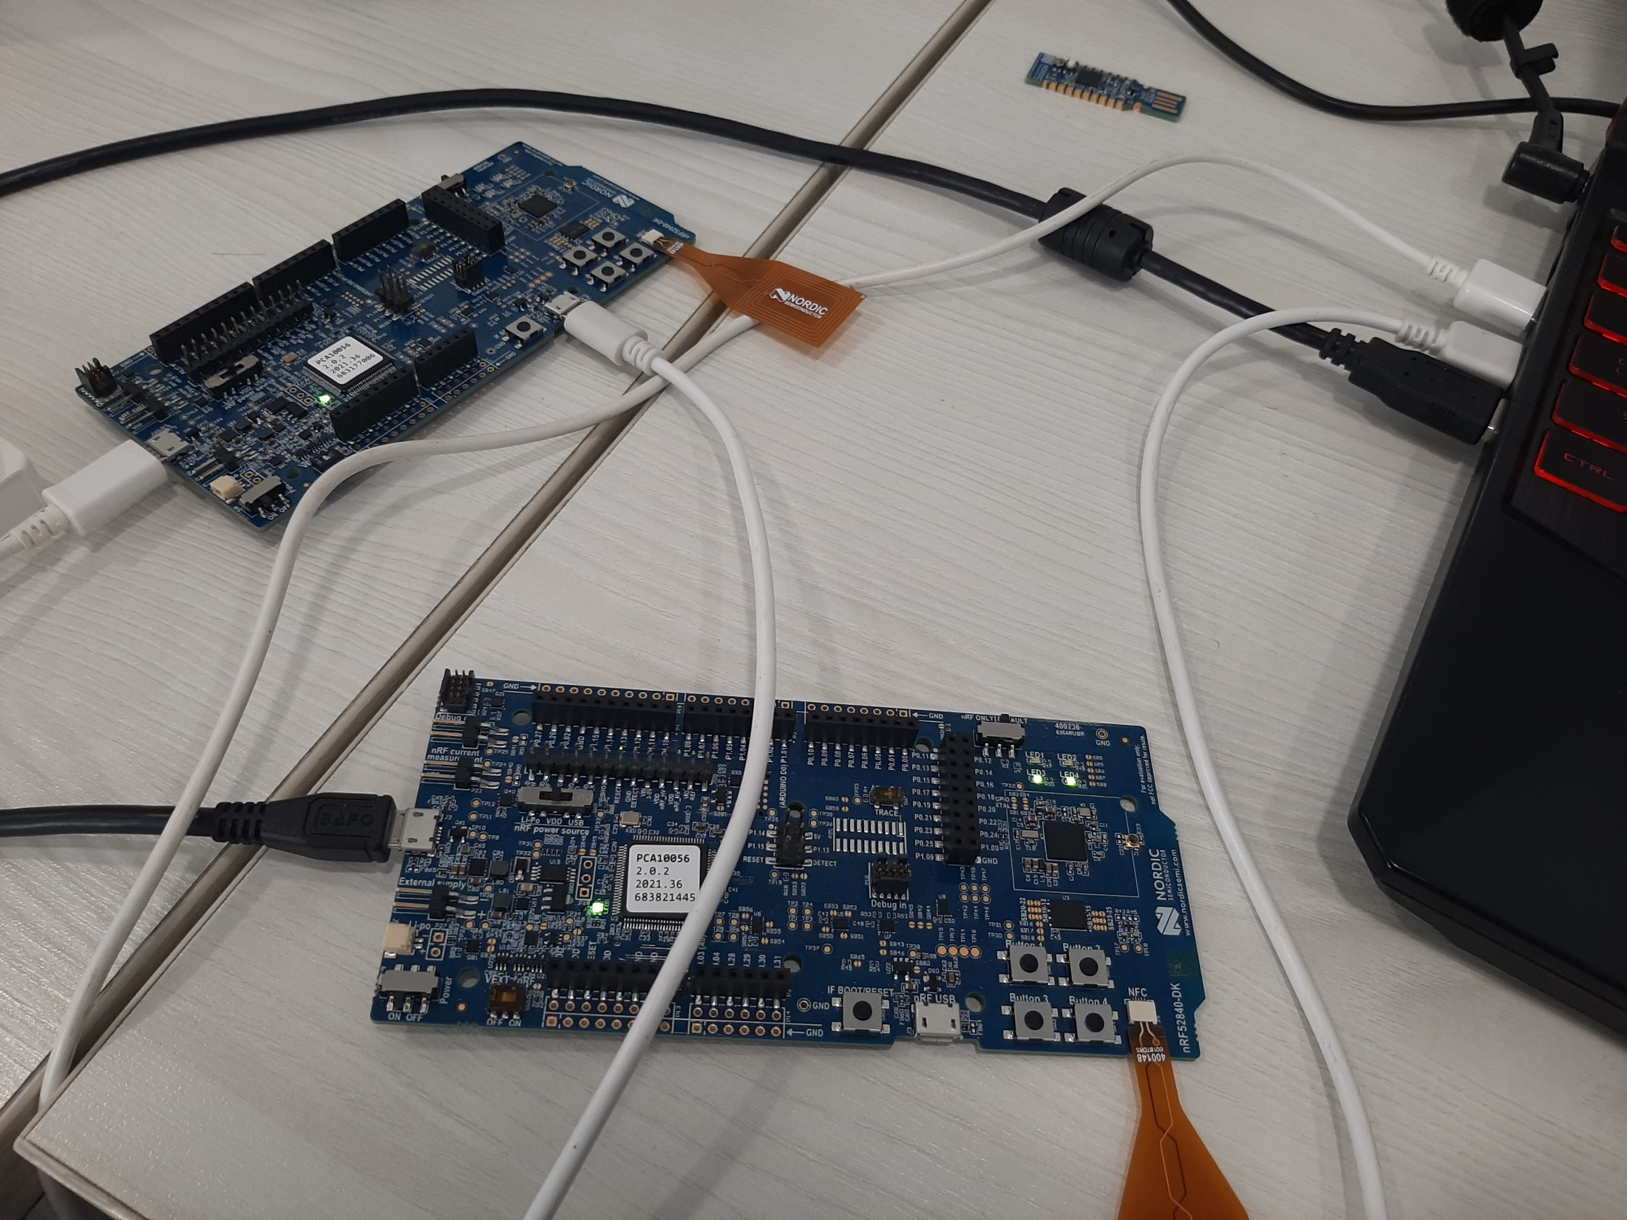
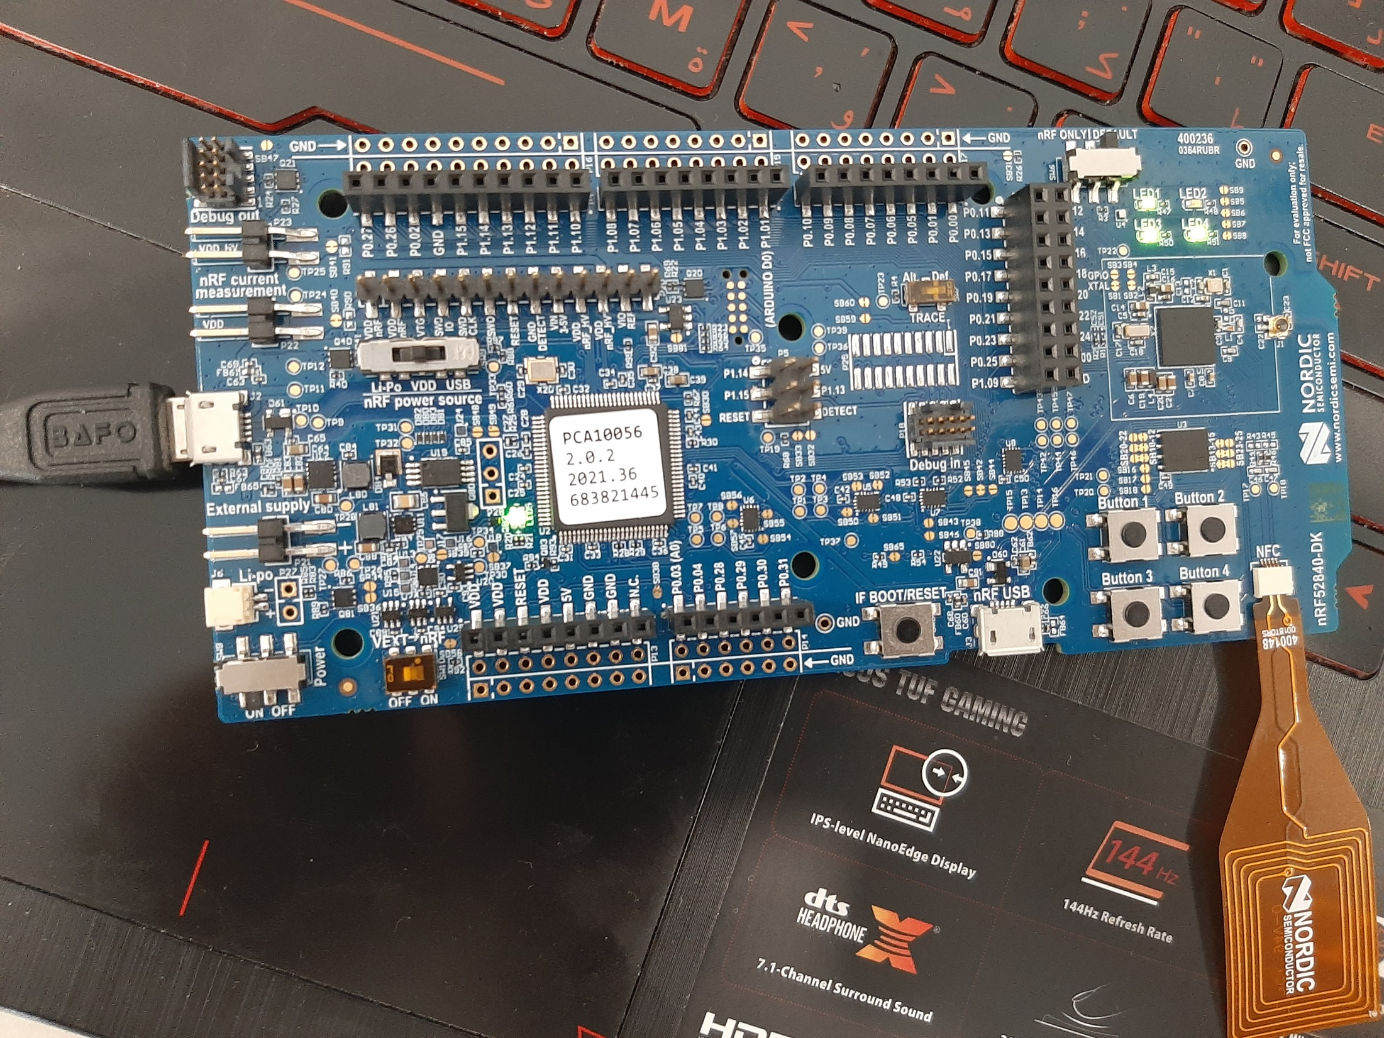
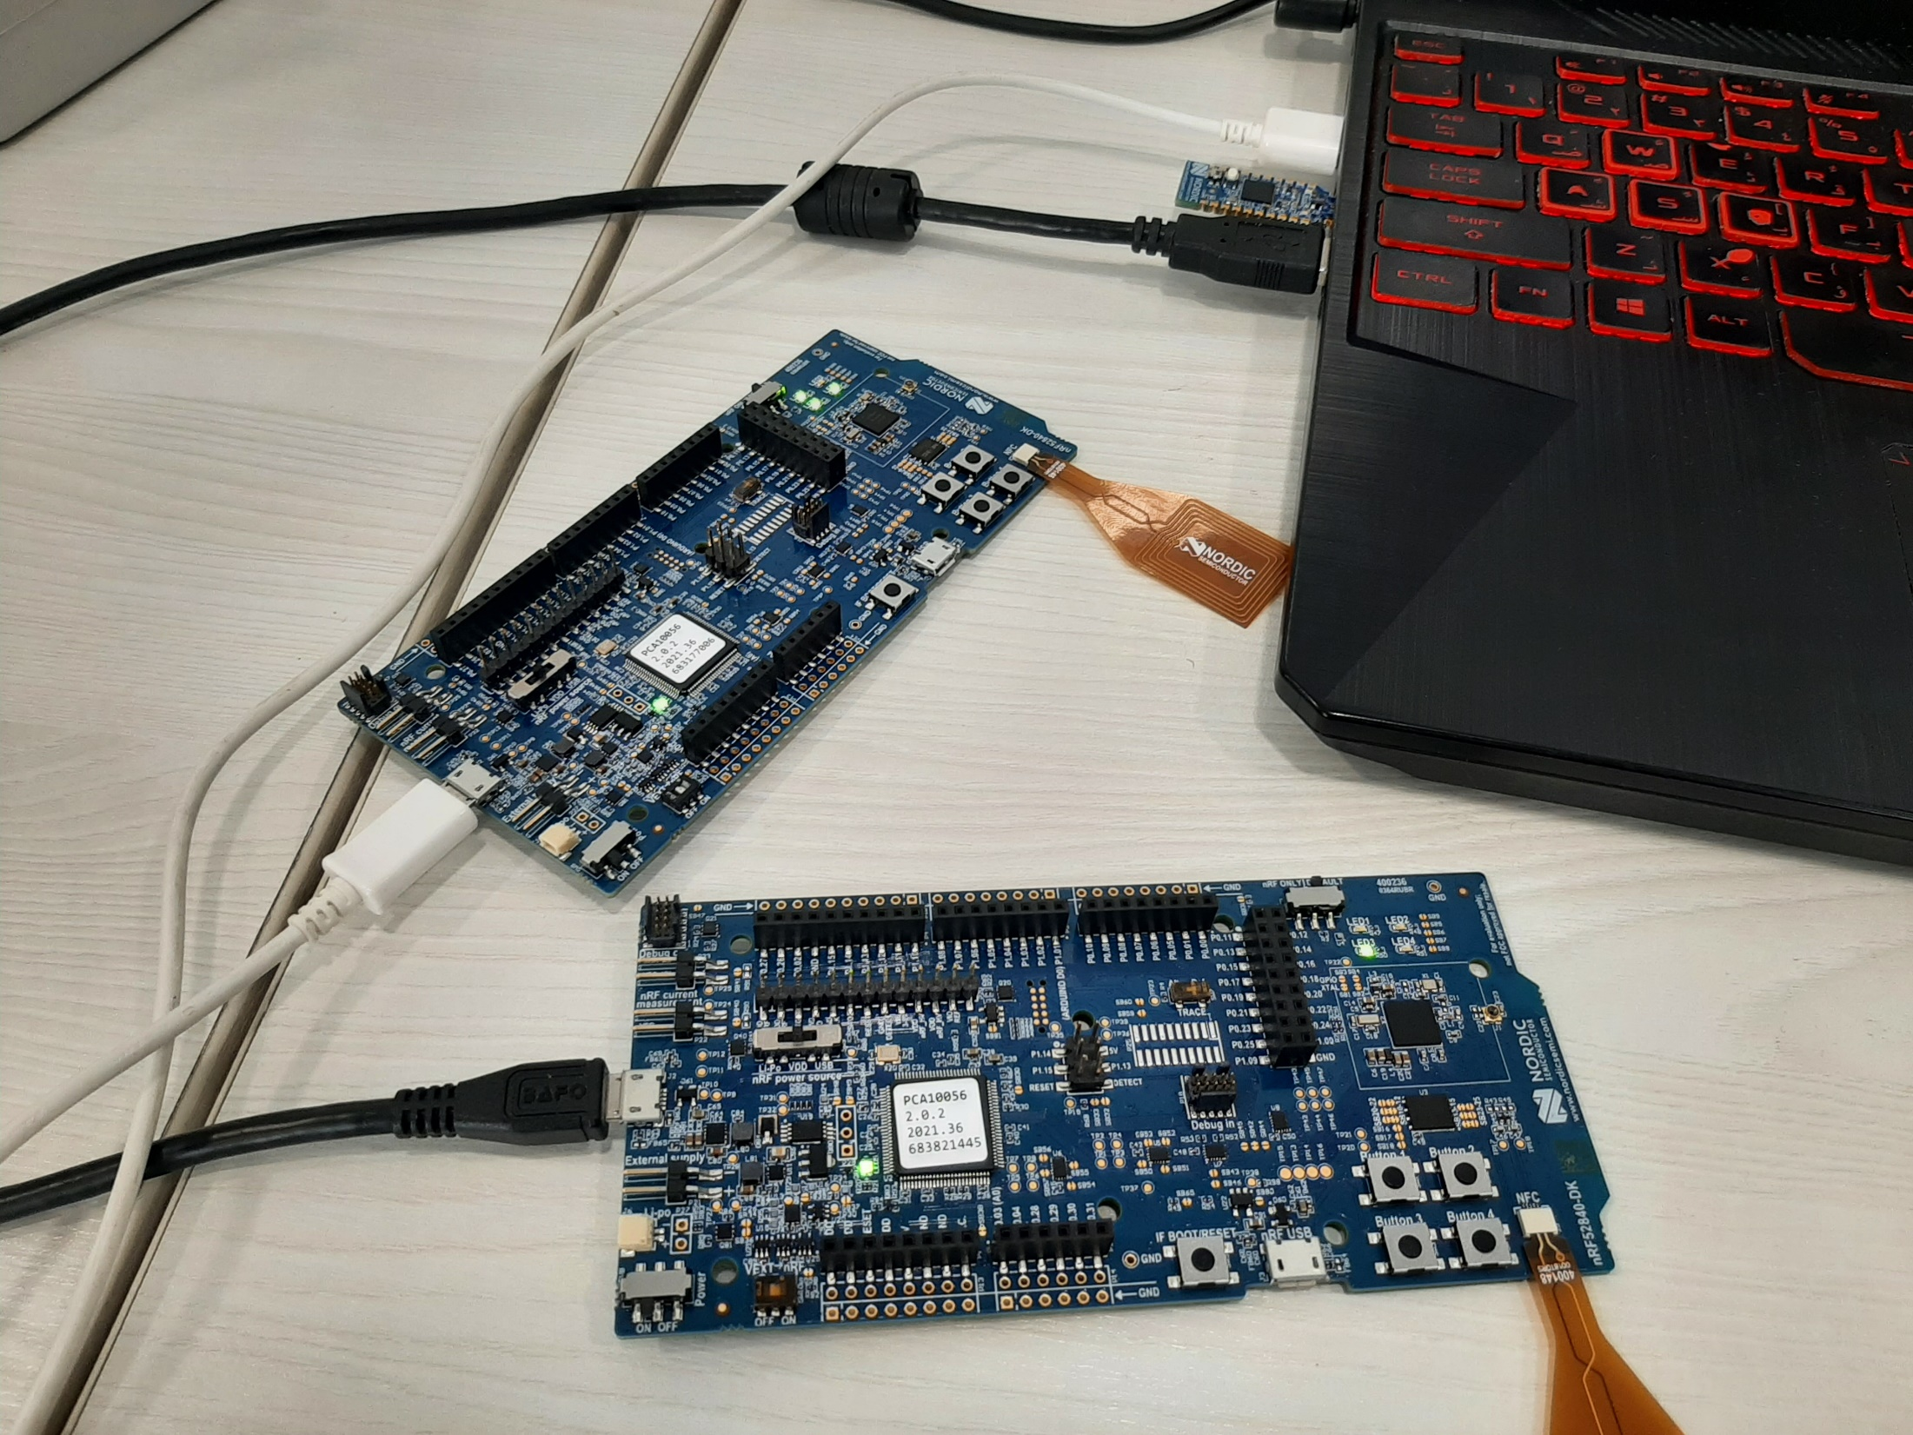
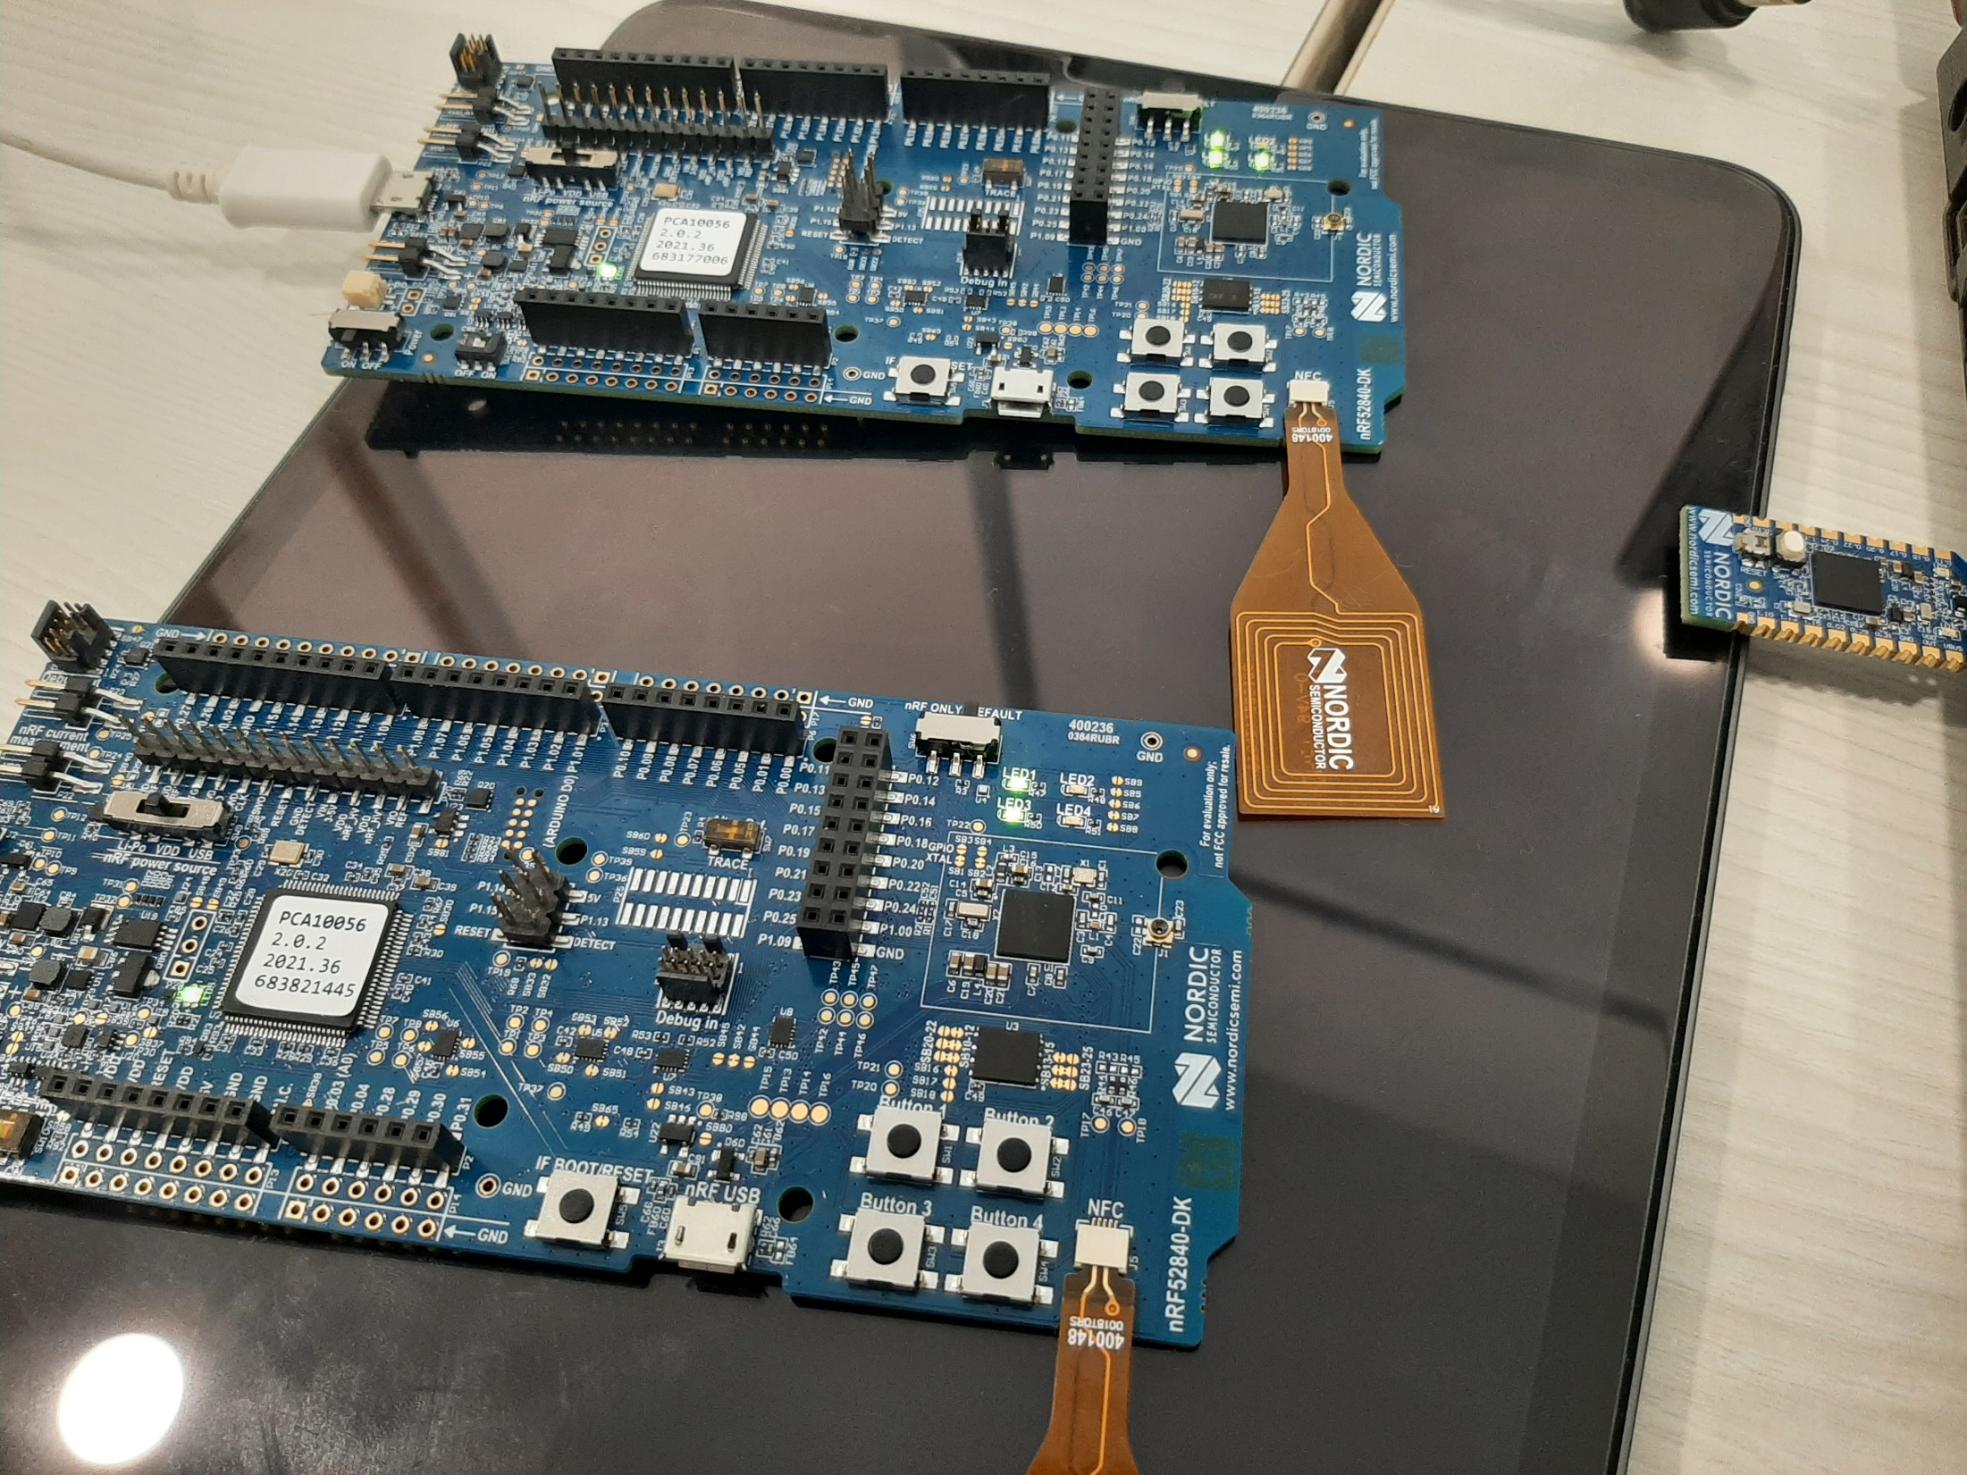
Network Co-Processor demonstration
Video 1:
Simple gw : dk
One light bulb: dk
Video 2:
Simple gw : dongle
One light bulb: dk
Video 3:
Simple gw : dongle
two light bulb: dk
Video 4:
Simple gw : dongle
One light bulb: dk
One light switch: dk

